Slide 1

Visual Rendering for VR
CS 498VR: Virtual Reality
UNIVERSITY OF ILLINOIS AT URBANA-CHAMPAIGN
Eric Shaffer

Slide 2
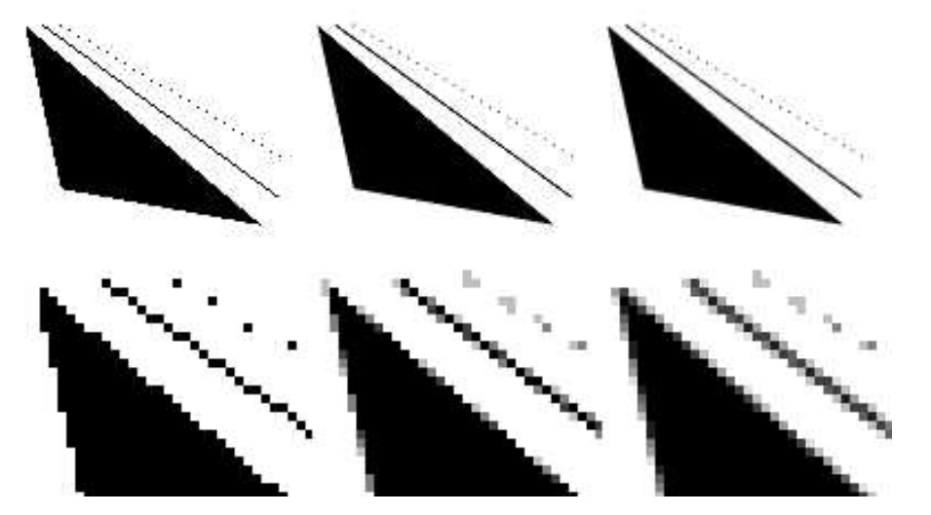
Aliasing and Anti-aliasing
Rasterization can result in “jaggies”
Each pixel is either on or off
When animated, jaggies become “crawlies”
More noticeable
More significant issue for VR than generic 3D graphics
Solve/reduce aliasing by multi-sampling.
E.g. mix the pixels at the border of edge/non-edge region
1 sample per pixel 4spp 8spp
Notes:
Problem with VR: Each aliasing rendering is independent of each eye. Small motion in head mounted display; causes random aliasing changes from one frame to the next
Subdivide each pixel into multiple sub pixels and sample e.g. 4x4 grid and interpolate results. Soften called super-sampling.

Slide 3
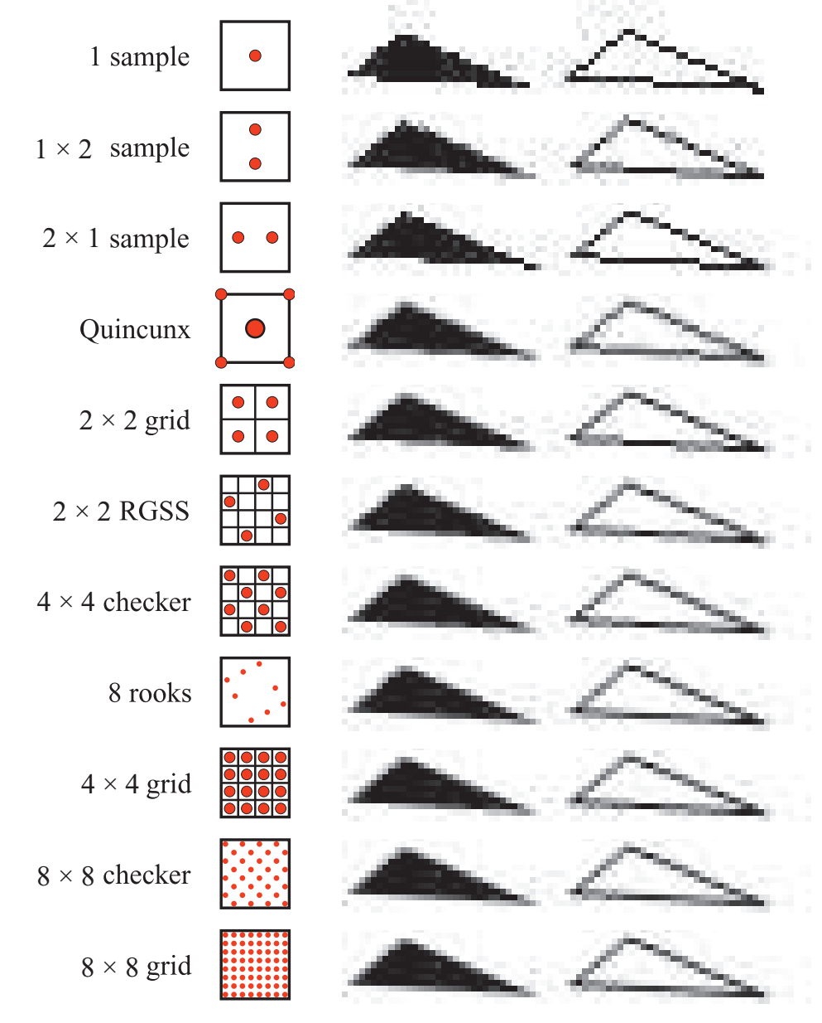
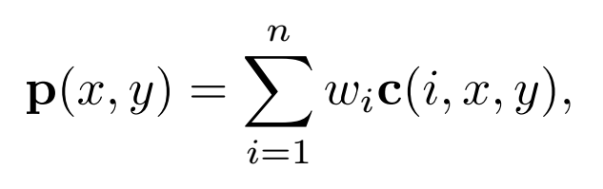
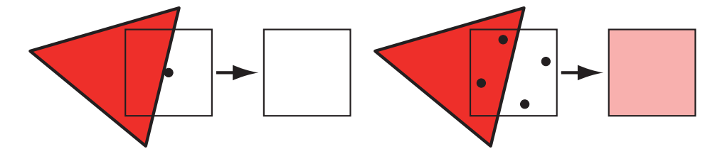
Multi-sampling
Construct pixel: average of multiple samples
C is a sampled color
w_{i} is a weight
….a lot of different schemes that can be used

Slide 4
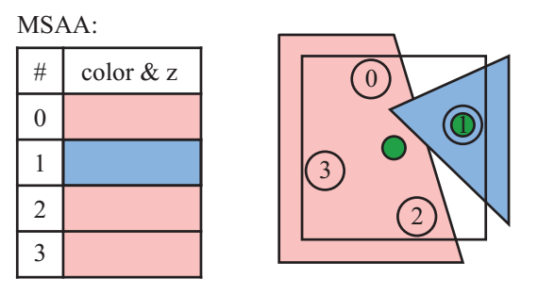
Multi-sampling
Screen-based anti-aliasing
Operate only using output samples from rendering pipeline
Full-scene anti-aliasing (FSAA) is simplest, just render at higher resolution
Multi-sampling anti-aliasing (MSAA)
Faster than (FSAA)
Computes shade of a surface only one per-fragment
Shade is used for each sample position covered by the fragment

Slide 5
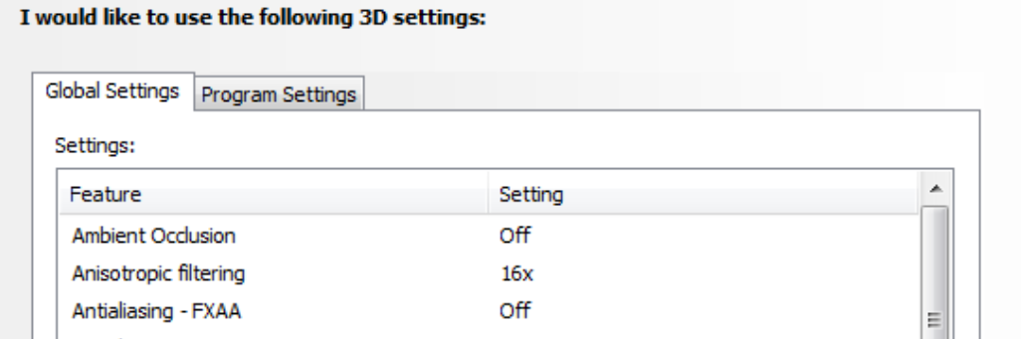
Temporal Anti-aliasing
Temporal anti-aliasing uses multiple frames to compute averages
NVIDIA Multi-frame Anti-aliasing (MFAA) is an example
Reprojection techniques keep a velocity buffer that tracks pixel-flow
Fast-approximate Anti-aliasing (FXAA) is popular
Take ~1ms per frame
FXAA is screen-based and temporal
NVIDIA Control Panel…Windows XP style interface but more powerful than GeForce Experience for tuning GPU parameters

Slide 6
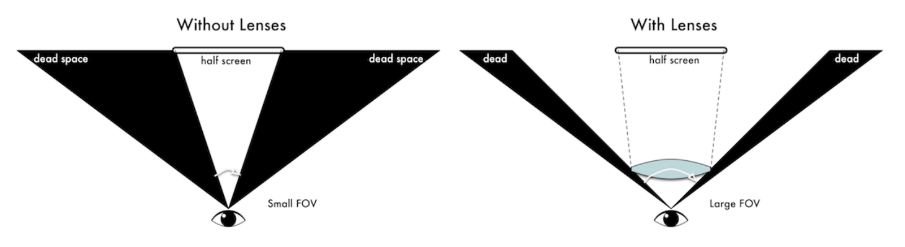
Optical Distortion
Recall optical distortion by our lens
VR HMDs use lenses to increase the field of view of the user
Notes:
(a) Original images. (b) Barrel distortion. (c) Pincushion distortion.

Slide 7
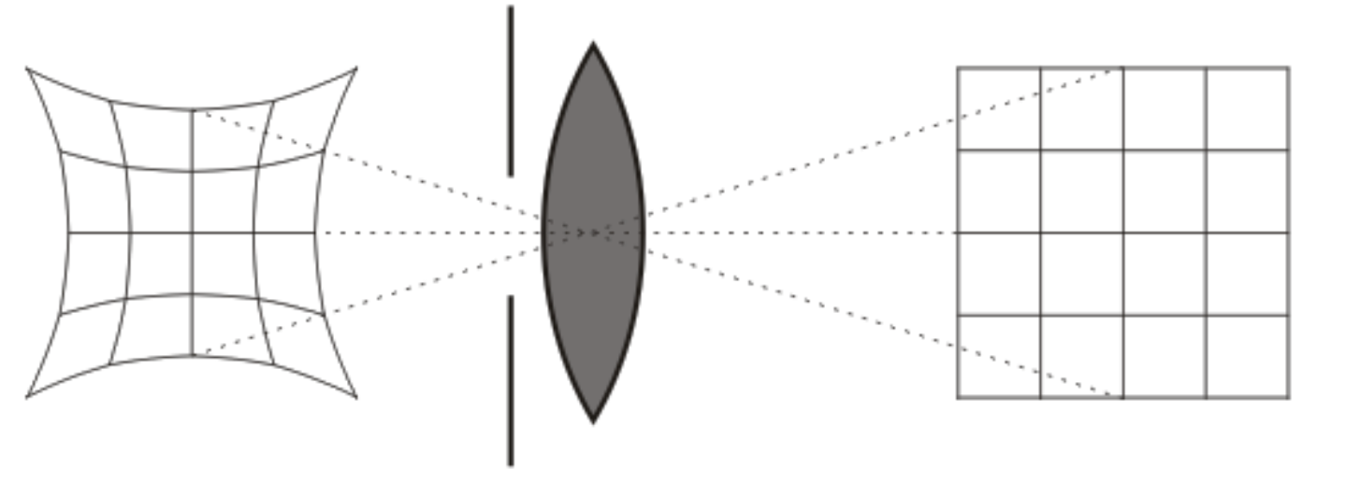
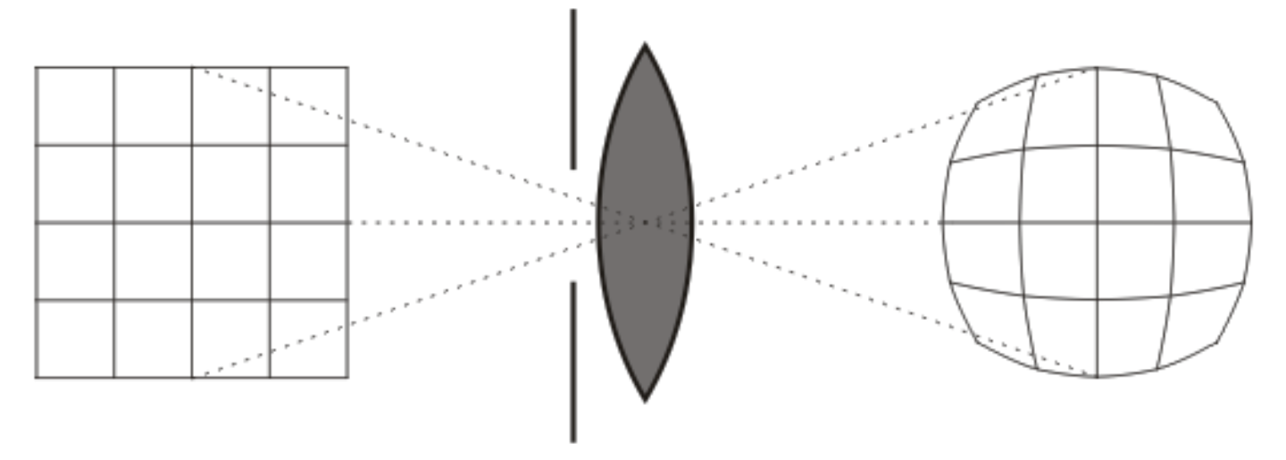
Optical Distortion
Typical HMD lens will generate pincushion distortion of image
Can be corrected by applying a barrel distortion

Slide 8
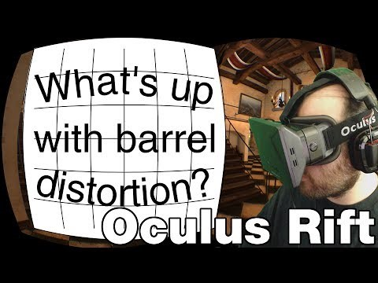
Barrel Distortion

Slide 9
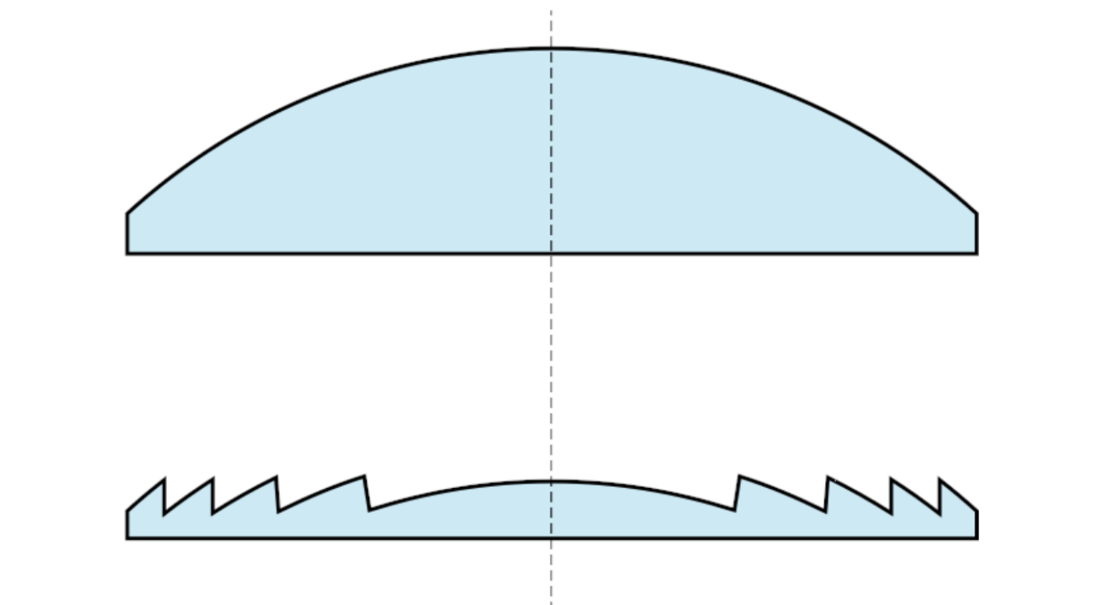
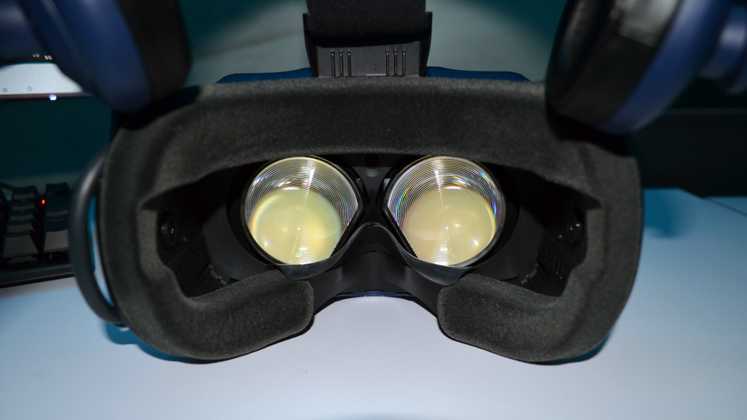
Hardware Solution to Optical Distortion
HTC Vive and Pro and Oculus Rift uses Fresnel Lenses
Also lighter than regular lens
But can exhibit glare from ridges
Can ameliorate spherical distortion
Pincushion still a problem

Slide 10
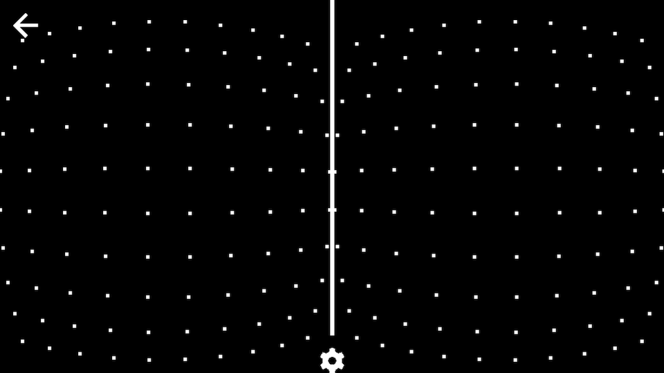
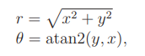
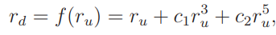
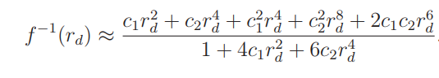
Correcting Optical Distortion
One image warping approach renders images into textures that would be applied to warped meshes
Consider referring to fragments in the canonical view volume [-1,1] x [-1,1] by polar coordinates
then a distortion is given by
c₁ and c₂ are constants you pick….c₁<0 generates a barrel distortion and c₁>0 generates pincushion
You need to find the inverse of the f giving a pincushion distortion…the is the corrective barrel distortion
It can be approximated as
…or more exact numerical methods can be used to find a better approximation.
Finding the correction function is done prior to runtime for a given lens setup.
Notes:
P(r) is trying to do polynomial (e.g. Taylor) approximations for the radial transform.

Slide 11
Challenge in VR: Latency
Latency: time it takes to update display in response to head orientation and position.
GPU pipeline has been optimized for triangle throughput, not latency
Some current methods for latency reduction:
Lower the complexity of the virtual world
Improve rendering pipeline performance
Remove delays along the path from the rendered images to switching pixels
Use prediction to estimate future viewpoints and world states
Distort the rendered image to compensate for last-moment viewpoint error
Notes:
More Practical suggestions on next lecture.

Slide 12
Latency by Example
Let d = 40 be the pixels per degree (pixel density) in the HMD Let ω = 50^{०}/s be the angular velocity of the head,
Let the latency l = 0.02 s be the time to update the display
How wrong is the image before the update can occur?
d ω l = 40 tells us the image is off by 40 pixels
Does a perfect system exist?
Historical problems: The perfect system is impossible
Variable latency are even worse due to the inability to adapt. People are used to 60 FPS.

Slide 13
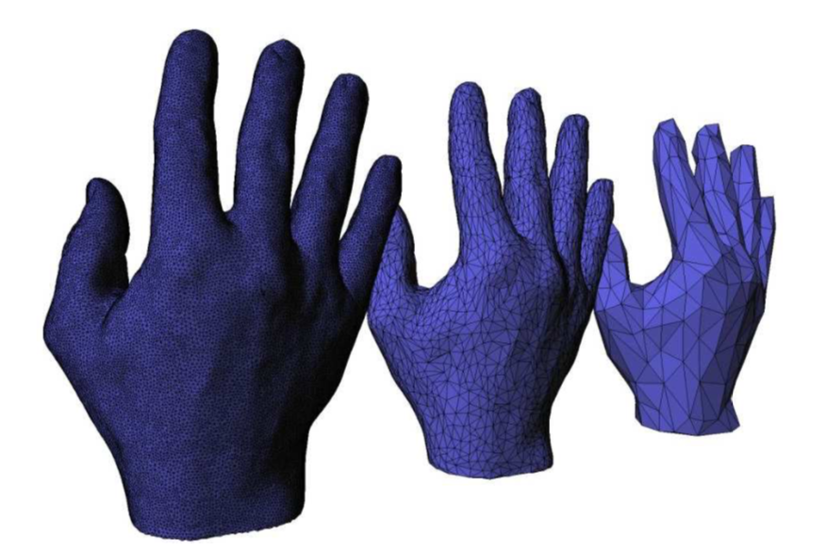
Simplify the Virtual World
Generate Levels-of-Detail using mesh simplification algorithms
Render far-away objects using coarser mesh
Lower the computational demands on the VWG (Virtual World Generator)
Notes:
Video1: 01-Vizup 3D mesh simplification and polygon reduction demo

Slide 14
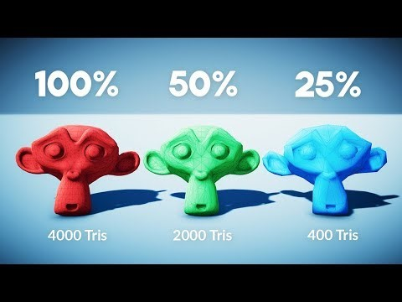
LODS in Unity
Unity has tools to setup and use LODs

Slide 15
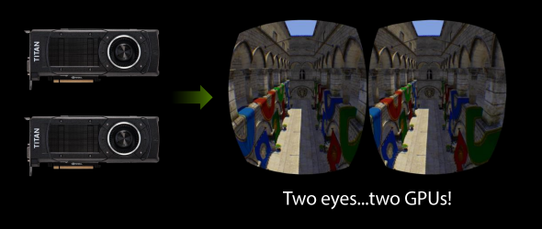
Parallel Rendering of Stereo Images

Slide 16
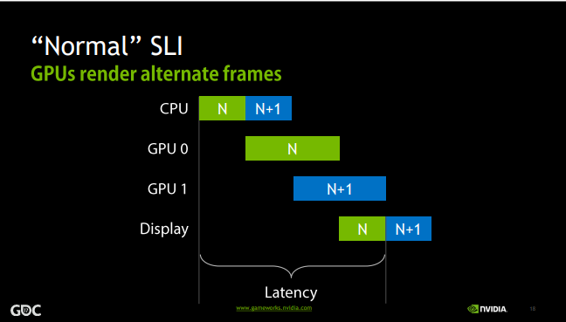
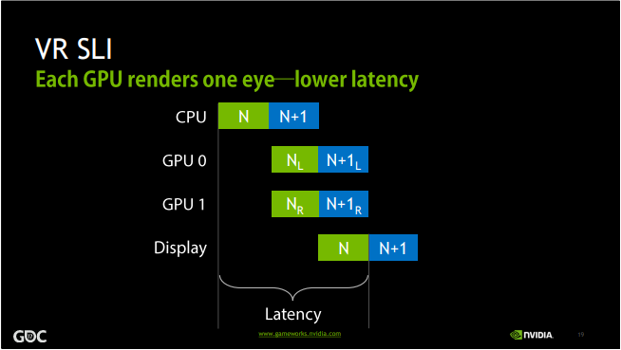
NVIDIA SLI for VR

Slide 17
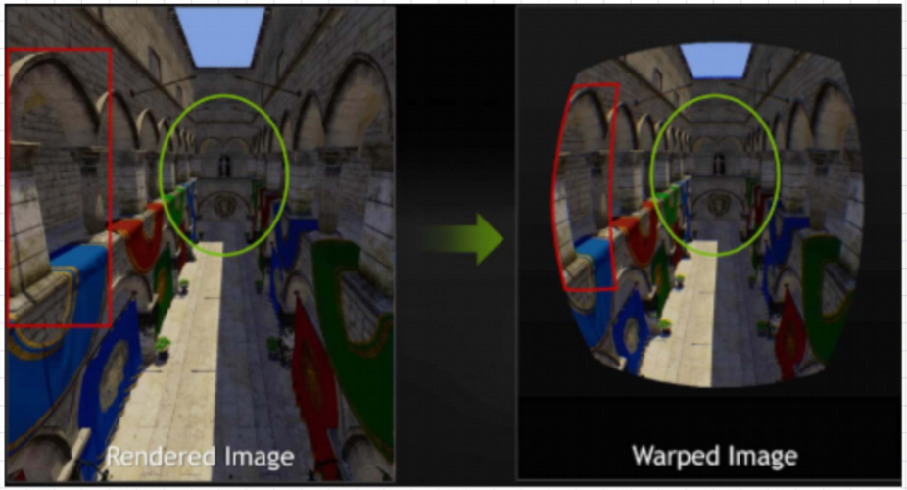
Optimizing Rendering for Image Warping
Current Approach. Optimization: Multi-resolution shading
Can you think of any rendering optimization we could do given that we know images will be warped?
What parts of the image could be rendered at a lower resolution?
Notes:
Classic rendering pipeline does not account for distortion.
Future: Aliasing concerns for both eye rendering.

Slide 18
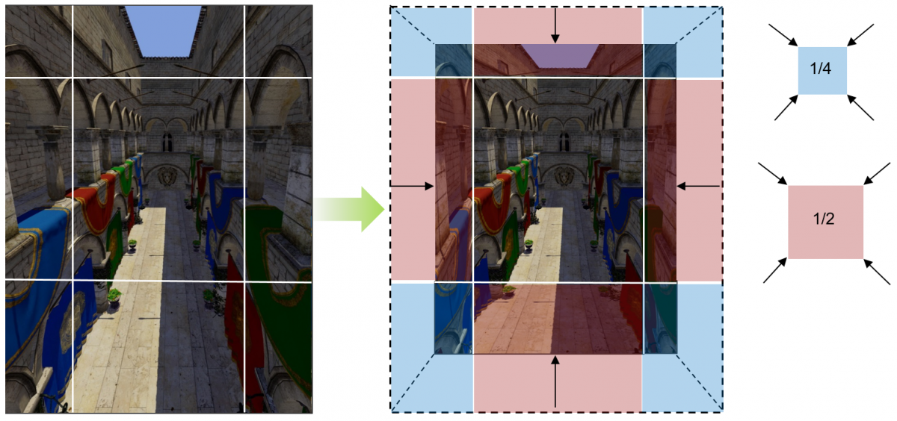
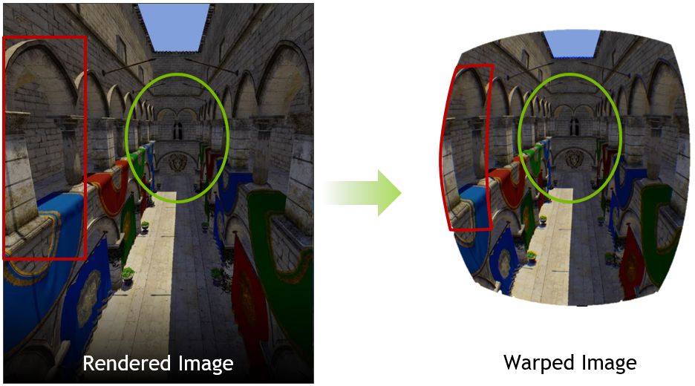
Optimizing Rendering for Image Warping
Current Approach. Optimization: Multi-resolution shading
NVIDIA Multi-resolution Shading breaks up view volume into pieces.
Renders the warped areas at lower resolution.
Notes:
Classic rendering pipeline does not account for distortion.
Future: Aliasing concerns for both eye rendering.

Slide 19
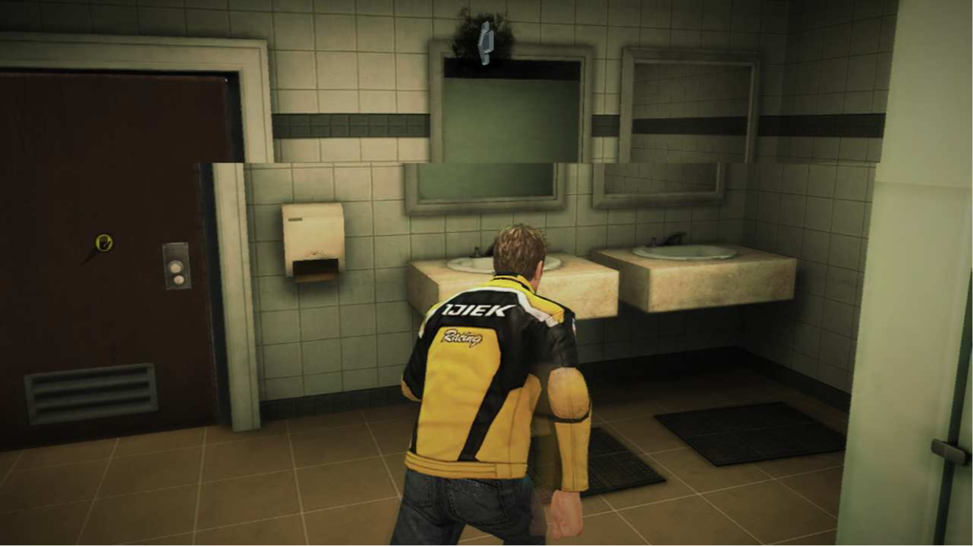
Images Tearing
Historically, CRTs required a Vertical Blanking Interval
Electron beam turned off as the gun was repositioned from bottom-right to top-left
In a single frame buffer systems it’s the time during which you can write to the buffer
If the buffer contents change during scan-out, you get tearing
Problem: Tearing
Notes:
What is “tearing”? And what is “blanking”?

Slide 20
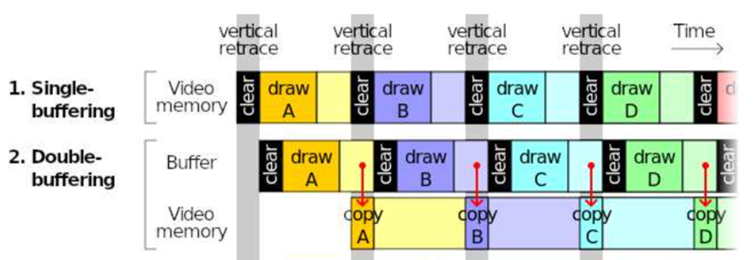
Solutions to Tearing
Buffering: Load frames into buffer not being scanned What implication does this have for VR?
Better solution would be
Simultaneous pixel update
Fast pixel switching (e.g. OLED display)

Slide 21
Accomodating Latency: Prediction
Three questions:
1. At what future time will the pixels be switched to the next image?
2. Where are the objects (position & orientation) at that time?
3. Where will the user be looking at that time?

Slide 22
Render the Future
Suppose we already know state of the viewer and world and time when pixels will be switched t_{s}
Produce a frame for time t_{s} and then perform visual rendering for the viewport at time t_{s}.
Zero effective latency

Slide 23
Predicting Movement
Object’s movement in dynamic world is easy to predict. User motion and object movement caused by user is hard to predict
Use Momentum and Inertia: Head has more inertia, finger has less inertia and harder to predict
Head movement is predictable on the scale of 20ms.

Slide 24
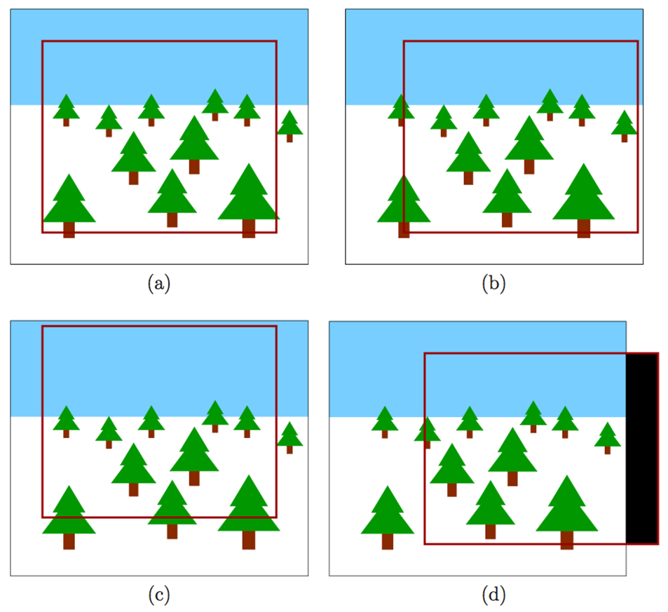
Post-rendering Image Warp
Rendered image is slightly larger than the display
Can then use shifts or distortion to compensate for bad prediction

Slide 25
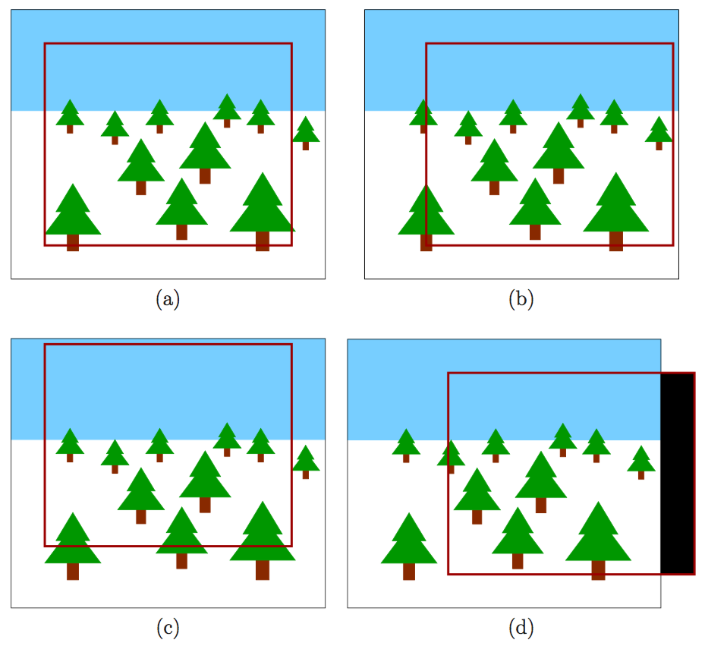
Post-rendering image warp
This is orientation change

Slide 26
Flaws in the Warped Image
Orientation changes (rotate head) are OK
But positional changes (translate head) are incorrect!
Visibility event: Part of a object may become visible only in the new viewpoint

Slide 27
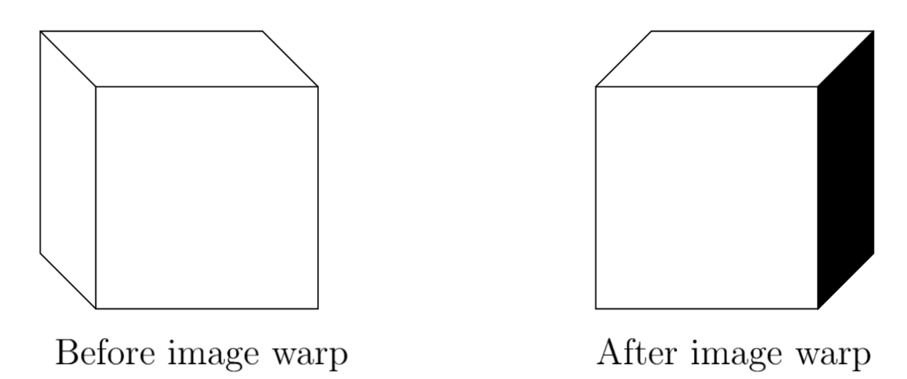
Visibility Event
Solutions:
Data structures: aspect graph & visibility complex
Parallel processing to sample several future viewpoints and render image for all of them

Slide 28
Increasing the Frame Rate
Inbetweening and tweening: insert warped frames for every rasterized image that is properly rendered
Example:
1 rasterized image per 100ms -> 10 FPS
(1 rasterized image + 9 warped frames) per 100 ms -> 100 FPS

Slide 29
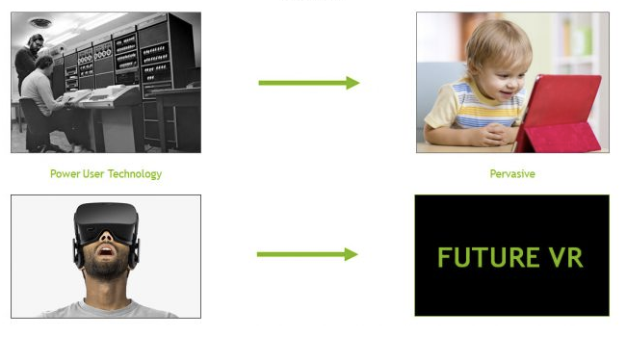
Current(ish) Research in VR Display Pipeline
Based on article: How NVIDIA Research is Reinventing the Display Pipeline for the Future of VR by Dr. Morgan McGuire
From 2017…you can find it with the Google

Slide 30
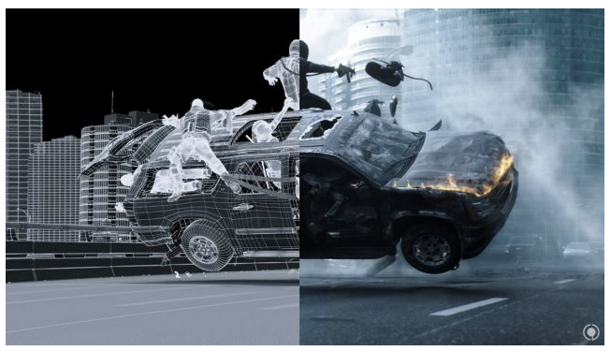
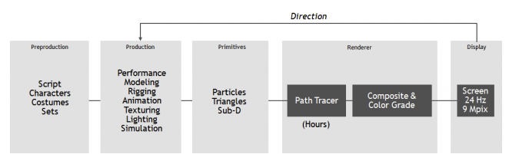
Background: Cinematic CGI Pipeline

Slide 31

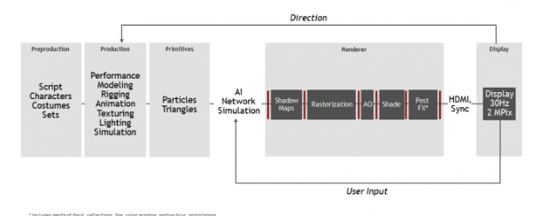
3D Game Pipeline

Slide 32
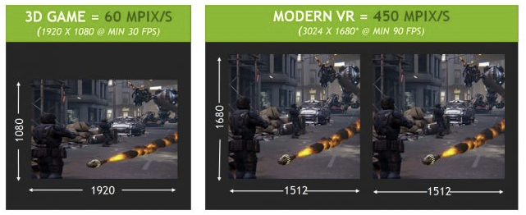
Modern VR Systems
Increased Throughput
450 Mpix/s on Rift or Vive is 7x of standard 1080p at 30fps
Must Reduce Latency
100-150ms between player input and pixel change in traditional game
Need to reduce this by a factor of at least 7 for VR

Slide 33
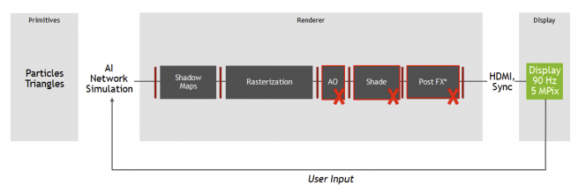
Reducing Latency
Reducing the number of pipeline stages reduces latency
No deferred shading?
No post fx passes
Reduced throughput and image quality

Slide 34
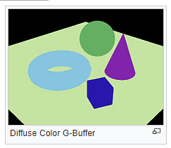
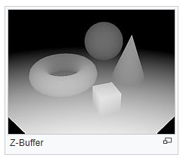
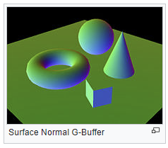
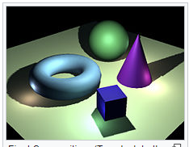
What is Deferred Shading?
No shading done in first pass of vertex and fragment shaders
Instead positions, normal, material info is gathered
Stored in the G-Buffer (geometry buffer) using render to texture
Final pass performs shading
Advantage: shading is only performed on pixels that will be seen

Slide 35
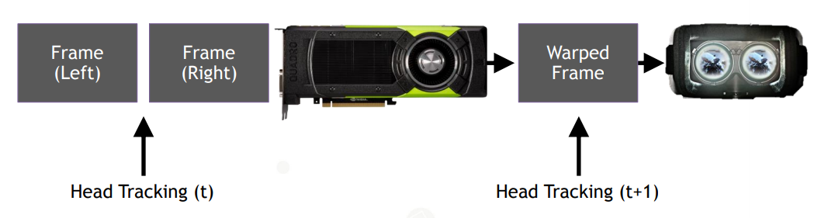
Time Warp
Images shown updated without full trip through the graphics pipeline Tracking data are routed to a GPU stage that appears after rendering is complete Warps the already-rendered image to match the latest head-tracked data This brings the perceived latency down from about 50ms to zero in the best case.

Slide 36
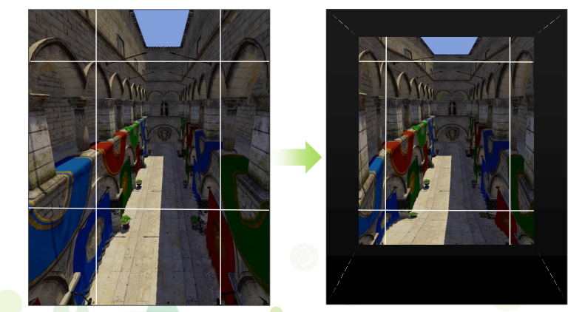
Lens Distortion: Multi-Resolution Shading
Image must be distorted to correct for lens
Can use that knowledge to optimize rendering
Multi-resolution shading
Subdivide image
Shrink the outskirts

Slide 37
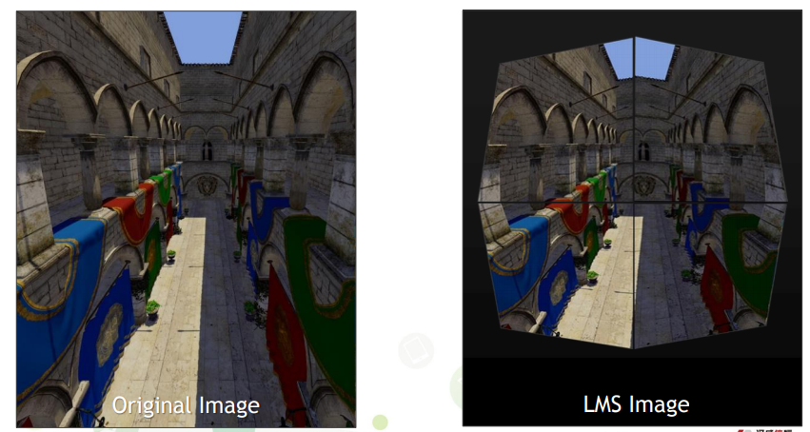
Lens Distortion: Lens-Matched Shading
Slightly newer technique
Uses 4 sub-images and distorts geometry in clip-space

Slide 38
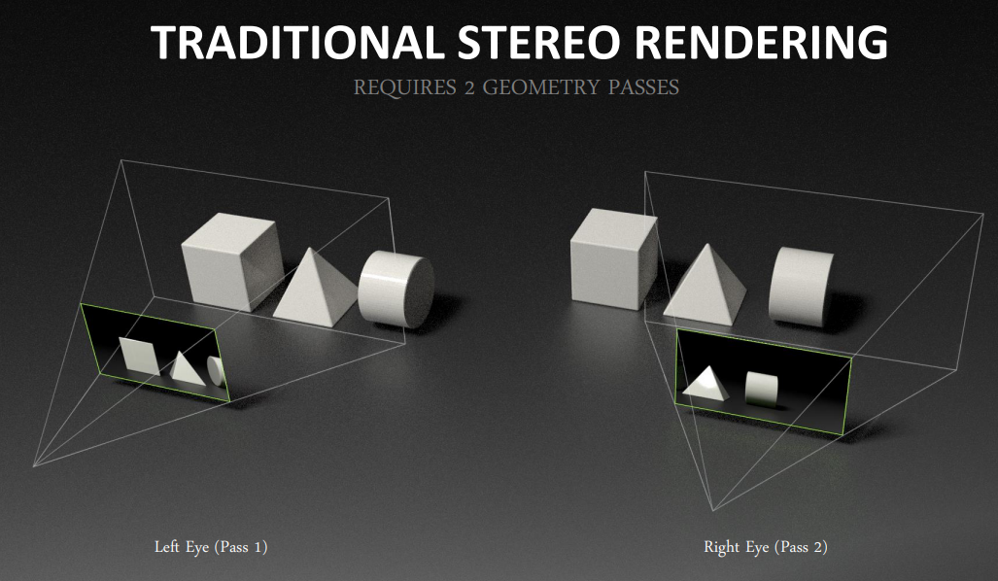
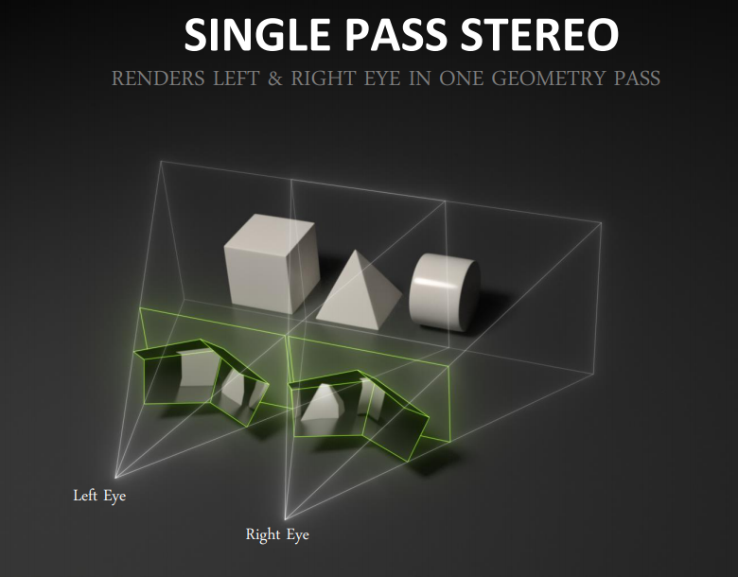
Simultaneous Multiprojection

Slide 39
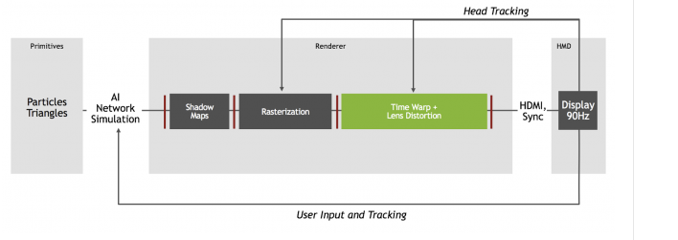
Modern VR Pipeline

Slide 40
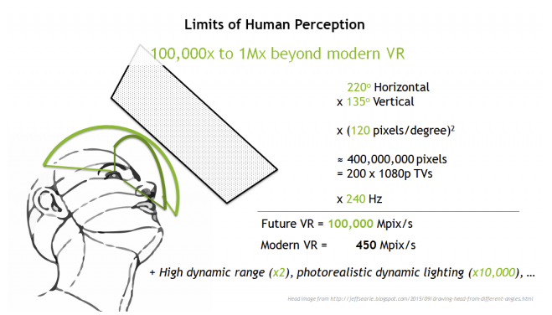
What Would be the Perfect VR Display?
Equivalent to 200 HDTVs updating at 240 Hz 100,000 megapixels per second
Need 200x performance increase

Slide 41
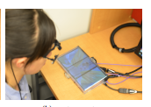
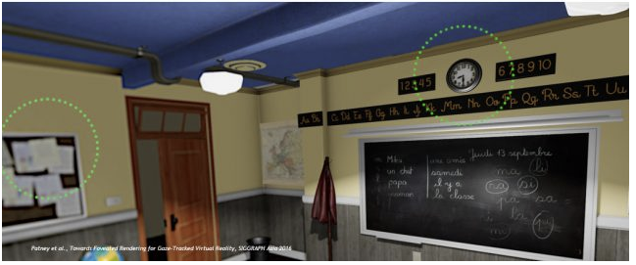
Future: Foveated Rendering
Track eye…render at lower res on periphery

Slide 42
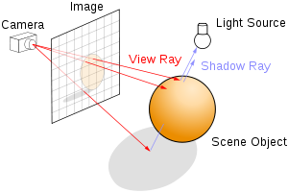
Real-Time Ray Tracing
Volta architecture: ~1 billion rays/per second (almost good enough)
Ray-tracing
removes the need for shadow map generation
can render lens distortion directly
can update each pixel on the fly…no frames?

Slide 43
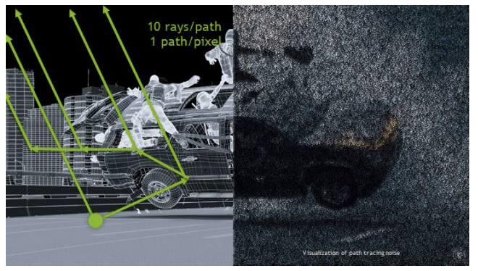
Real-Time Path Tracing
Path-tracing is ray-tracing…with more recursion
Generates indirect lighting effects (global illumination)
A single path per-pixel will be noisy…need thousands
So…maybe 1000x more expensive than simple ray-tracing

Slide 44


Image Denoising
New image denoising functions generated through machine learning
…faster than shooting more rays

Slide 45

Solving Vergence-Accommodation

Slide 46

Solving Vergence-Accommodation

Slide 47

Solving Vergence-Accommodation
SIGGRAPH Asia 2017

Slide 48

Solving Vergence-Accommodation
Track the eye and distort image depth of field to match

Slide 49

Computing on the HMD
Local GPU(s) in HMD plus Cloud-based GPU

Slide 50

Computing on the HMD

Slide 51

What do you think?

Slide 52

Ray Tracing
Follow ray of light….
Can trace from an eyepoint through a pixel
See what object the ray hits…
Compute the color of the light being reflected from the hit point.

Slide 53
Ray Tracing: Extremely Flexible
Can simulate global visual effects such as
Mirror-like reflection
Transparency and translucency
Global illumination (indirect lighting and color bleeding)
Soft shadows….
And mores……

Slide 57


Ray-Tracing: Computationally Intense
LOTS of rays get generated
Each pixel requires multiple primary rays for anti-aliasing
Each hit on a surface recursively generates more rays
Cornell Box About 100,000 rays per pixel

Slide 58
Real-Time Ray-Tracing

Slide 59

NVIDIA RTX: Real-Time Ray-Tracing Demo

